Slide 1
Pre-Departure Meeting
Preparing for your ACIS Trip and What to Expect While Abroad

Slide 2
Agenda
Behavior Guidelines
What to Pack
MPC App
Flights
On Tour
Arrival Day
Your Tour Manager
Meals
Staying in Touch
Tips from Experience
The “F Word” of Travel
Questions

Slide 3
Behavior Guidelines
Know the rules before you go:
Following the rules is the best way to ensure that everyone gets the most out of their educational travel experience.
www.acis.com/behavior-guidelines
Part of the fun of traveling is meeting new and interesting people!

Slide 4
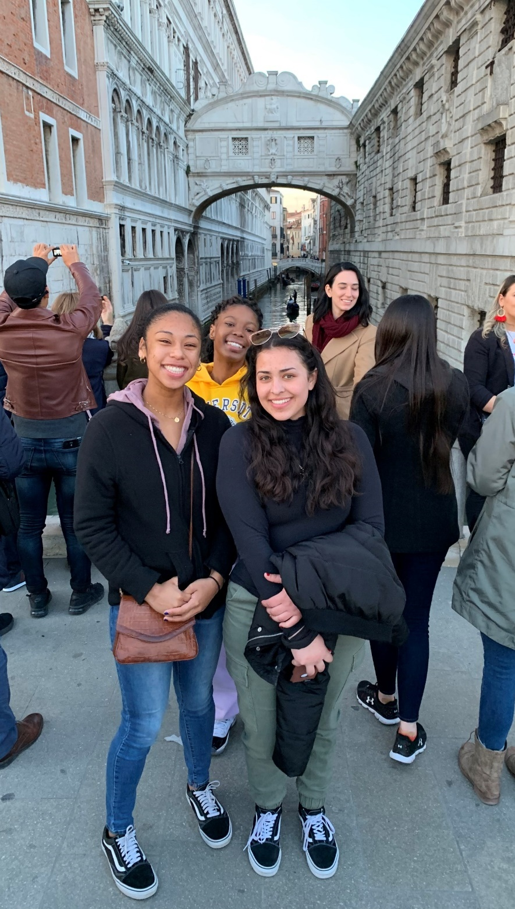
What to Pack
Always check the weather forecast
Your hand luggage (backpack)
Your suitcase (make it a carry-on!)
Masks and hand sanitizer
Chargers
Lost/delayed luggage can happen – be prepared
A watch to stay on time!
For pro packing tips, visit www.acis.com/getting-ready/packing-tips

Slide 5
Mobile Passport Control (MPC) App
Streamline Your U.S. Customs Entry Process at MPC-Approved Sites:
www.cbp.gov/travel/us-citizens/mobile-passport-control
Awesome for short connections
Download a free, secure app; No pre-approval required
Eligible travelers can submit their passport and customs declaration info on their mobile device
Check the website for a full list of approved airports
Used successfully by ACIS travelers in Boston, Dulles and JFK in the recent past
*Currently the MPC mobile app is available to U.S. citizens, U.S. lawful permanent residents, Canadian B1/B2 citizen visitors and returning Visa Waiver Program travelers with approved ESTA..

Slide 6
Flights
Arrive early: Check-in is taking longer
Patience
Any delays or missed connections – call the ACIS Duty Officer
IMPORTANT NOTE
Any required entry documents must be available for review by airline staff at check-in for your FIRST FLIGHT (even if it is a domestic connecting flight).

Slide 7
On Tour:
Arrival Day
Getting into town – Your ACIS Tour Manager will meet you at the airport and bring you to the hotel. You likely will not be able to check in when you arrive, but you will be able to store your bags.
Don’t nap – Freshen up and resist the temptation of an afternoon nap. You will recover from jet lag faster if you stay active during the day and then go to bed at a reasonable hour.
We’ll keep you busy – Your tour manager will get your group out-and-about within the city and acclimating to the culture.

Slide 8
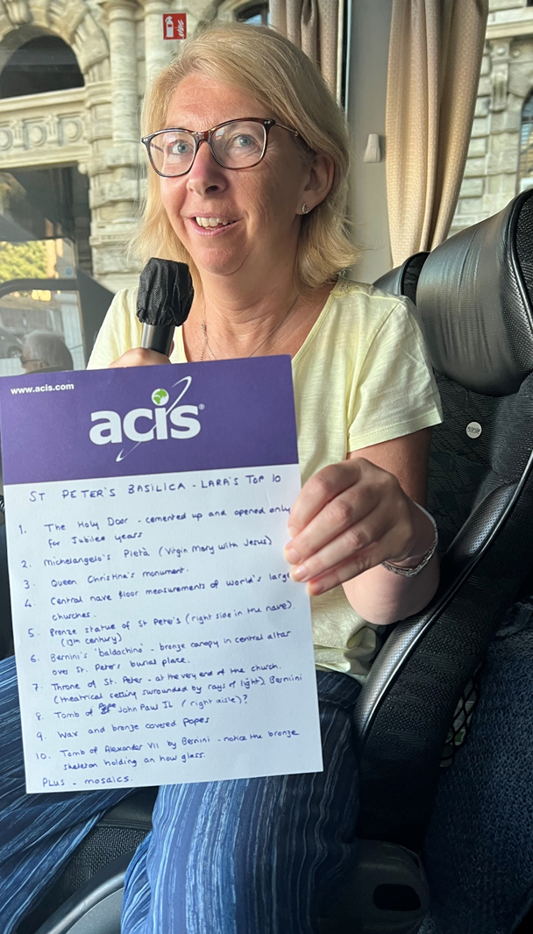
Your Tour Manager
Your Tour Manager is:
Responsible for travel logistics, educational road commentary, and adding a unique perspective to your trip
Multi-lingual, knowledgeable, and energetic!
A great resource for maximizing your exploration time
Available to you 24 hours a day to solve any emergency situation
Help your Tour Manager and Group Leader(s):
Be punctual
Respect curfew and behavior guidelines
Communicate with them clearly
Thank them for working hard to make your trip the best it can be!

Slide 9
Meals
Breakfast and dinner are included daily (unless otherwise listed on your itinerary)
Enjoy a mixture of authentic and familiar cuisine
Let us know about special meal requests (vegetarian, allergies, etc.) in advance
You never need to tip your waiters at ACIS meals

Slide 10
Staying in Touch + Social Media
Make a plan for communication back home
Create a group hashtag
Include/tag @acistours and #acistours on your posts – make sure you are following!
Like to write? Create a blog post for ACIS upon your return!

Slide 11
For Travelers:
Pack light
Practice walking long distances
Download the ACIS Travel App
Have some local currency on hand
Call your bank
Be punctual!
Be prepared for cultural differences
For Parents:
Independence and growth
No news is good news
Use social media
Travel changes lives!
Tips from Experience

Slide 12
The “F Word” of Travel
FLEXIBILITY!
Expect the unexpected
Go with the flow
Embrace your sense of humor
Be proactive

Slide 13
Questions?
Post-Meeting:
Ask your Group Leader
Visit our FAQ page: www.acis.com/faqs
Live Chat with a member of our team at acis.com, Mon–Fri, 10am to 5pm ET
Email accounts@acis.com

